Slide 1
Highland Creek Elementary School
Read to Achieve
Notes:
*

Slide 2
Why the Focus on Reading Comprehension?
In order to prepare for secondary education and careers, you must be able to read, comprehend, integrate, and apply complex text.

Slide 3
What is Read To Achieve?
Read to Achieve is part of the Excellent Public Schools Act which became law in July 2012.
This law supports the NC State Board of Education’s mission:
  Every public school student will graduate from high school globally competitive for work and post-secondary education and prepared for life in the 21st century.
*
Notes:
Read to Achieve is part of the Excellent Public Schools Act which became law in July 2012 to support the NC State Board of Education’s mission:
- Every public school student will graduate from high school globally competitive for work and post-secondary education and prepared for life in the 21st century.
Effective during the 2013-2014 school year
Follow the hyperlink and go to pages 38 – 44 for the section of the law pertaining to Read to Achieve.
*

Slide 4
Goal for Read To Achieve
§ 115C-83.1. State goal.
“The goal of the State is to ensure that every student read at or above grade level by the end
of third grade and continue to progress in reading proficiency so that he or she can read,
comprehend, integrate, and apply complex texts needed for secondary education and career
success.”
(Excellent Public Schools Act, NC HB 950/S.L. 2012)
*
Notes:
Read the above quote from the law.
By the end of third grade, students are expected to be independent readers, which means they can read and understand words, sentences, and paragraphs and answer comprehension questions about their reading.
*

Slide 5
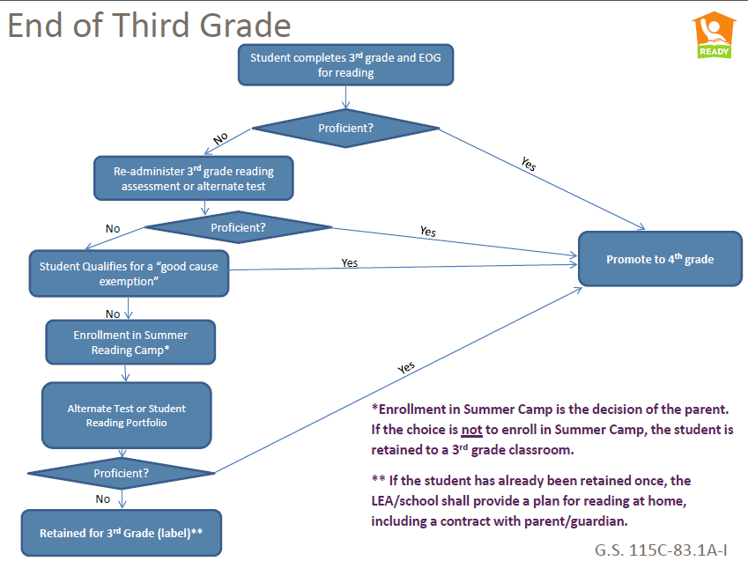
Notes:
Explain verbally the flowchart. Refer to the guidebook for more explanation.
A possible script:
The law requires third graders who score at Level 1 or 2 in reading on the third grade EOG be retained. However, in special circumstances students can receive what is called a “good cause exemption”. The law also states students will attend summer reading camp if they do not show proficiency after third grade and they do not qualify for good cause exemptions. This camp will be provided by CMS and will be of no cost to you. Students who show proficiency at the end of the summer reading camp by passing the Read to Achieve test or producing a completed reading portfolio will be promoted to the fourth grade.
(The “good cause exemptions” are explained on the next slide.)
*

Slide 6
Highland Creek Implementation
Intervention Groups began September 11th.
Students who meet the criteria for RTA will receive 45 minutes of additional instruction by certified staff. This instruction takes place 4 days a week.
This instruction will take place at 8:00-8:50 (RTA time)
Notes:
Glennon and Geary groups. Data Points that we used: MAP,BOG,READING 3D,COMMON ASSESSMENTS, - Caoolway and Bloomquist

Slide 7
What Can Parents Do to Help?
Read with your child every day. We have the Reading Challenge to encourage our students to read daily. Talk to your child about what they are reading (discussion stems).
Take children's books and writing materials with you whenever you leave home.
Help your child see that reading is important. Set a good example for your child by reading books, newspapers, and magazines.
Limit the amount and type of television you and your child watch.
Communicate with your child’s teacher.
Parent resources on 3rd Grade teacher’s wikis.
Stress to your children, that it is not how they start but rather how they finish – it’s about growth!
*
Notes:
These are some reading tips for parents recommended by the US Department of Education (http://goo.gl/0u4UQG).
*

Slide 8

Please visit the HCE website (RTA tab) for additional information.
Other concerns? Contact your child’s teacher with individual questions about progress and concerns.
*
Notes:
Are there any questions?
*

